Slide 1
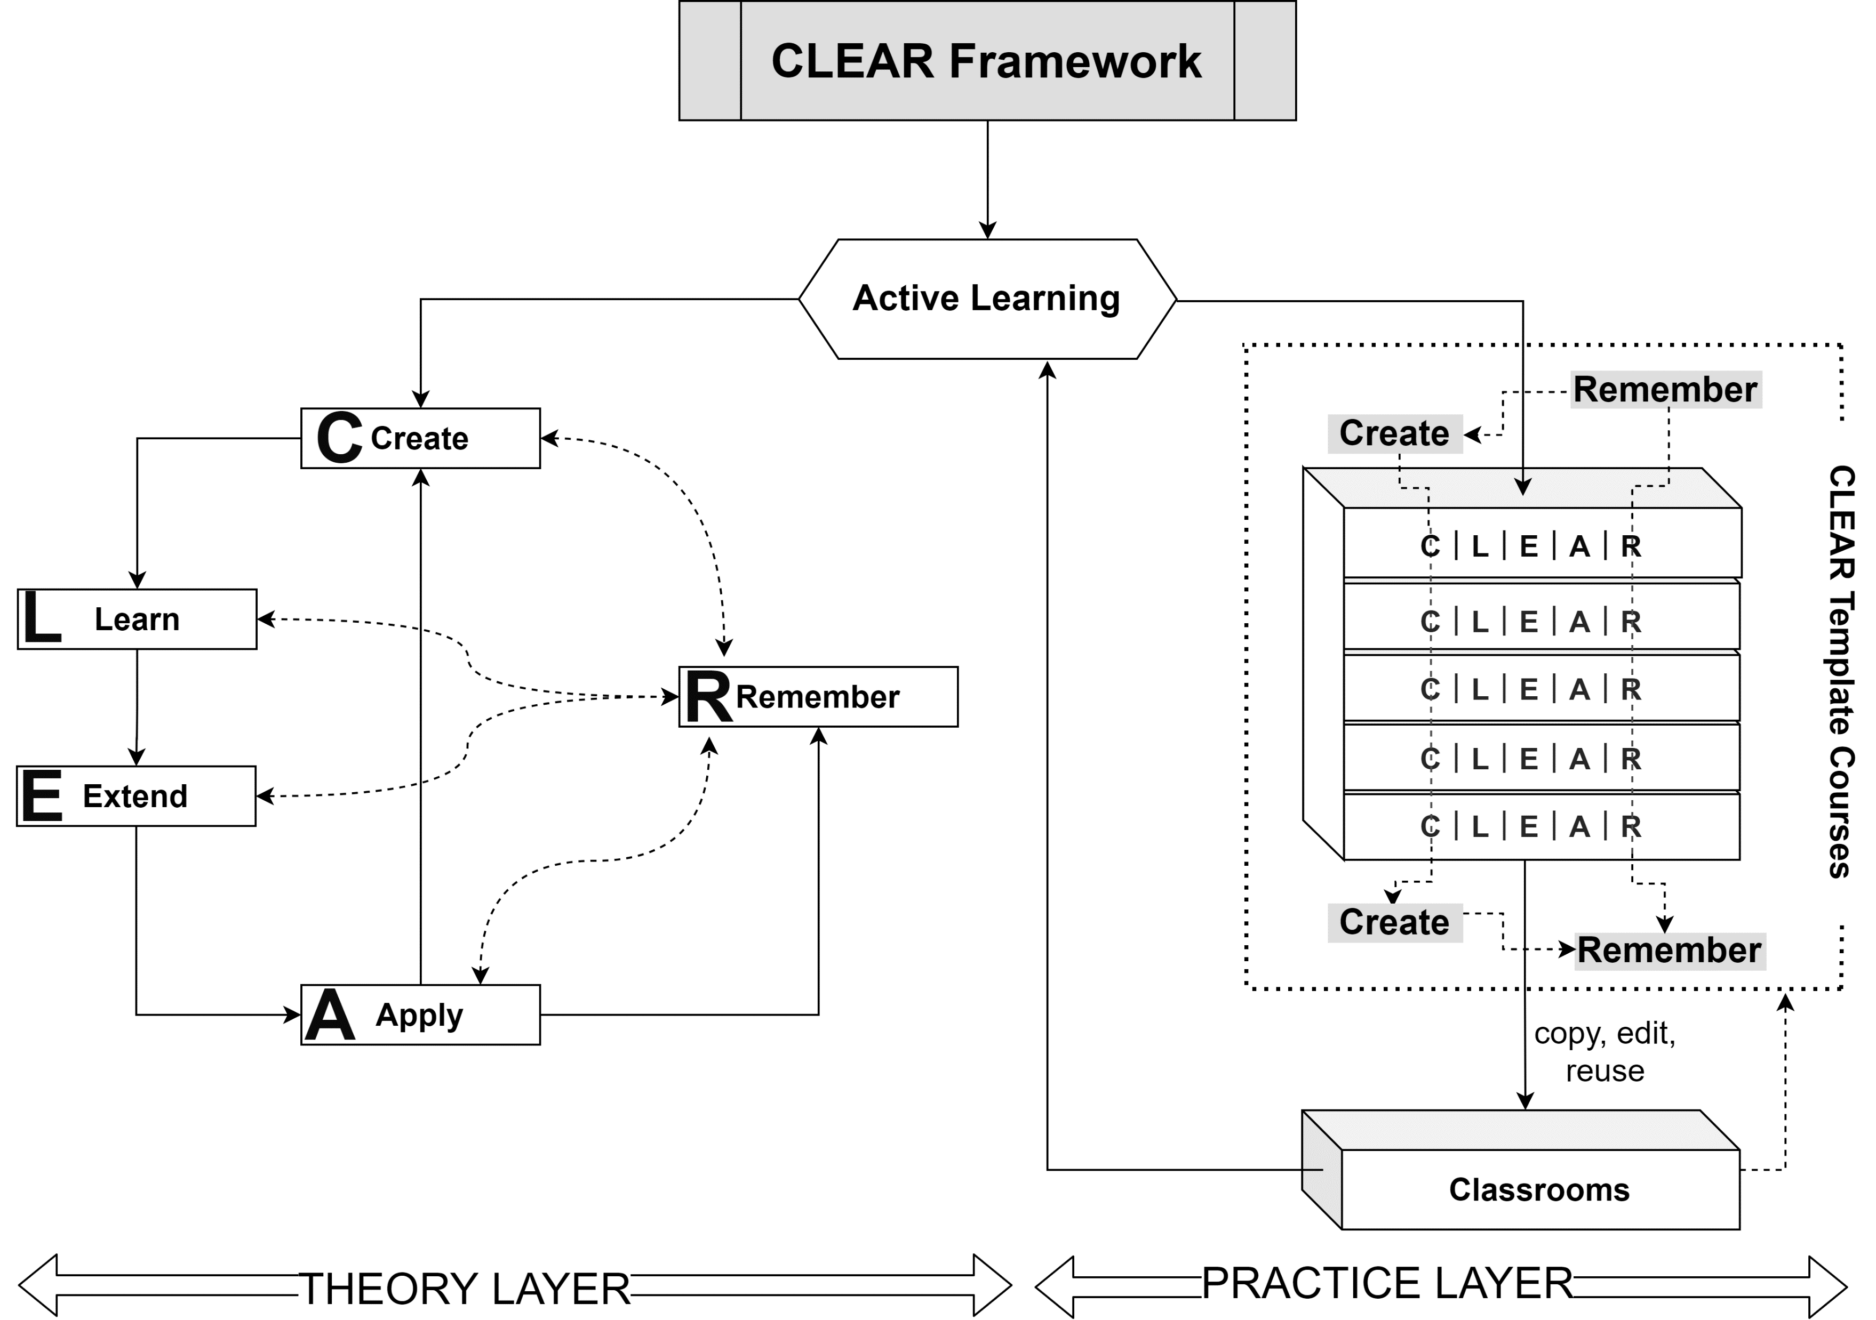
The CLEAR Framework to Implement Active Learning in STEM Education
Jingjing Lin Center for IT-based Education
Toyohashi University of Technology Toyohashi, Japan lin.jingjing.qc@tut.jp

Slide 2
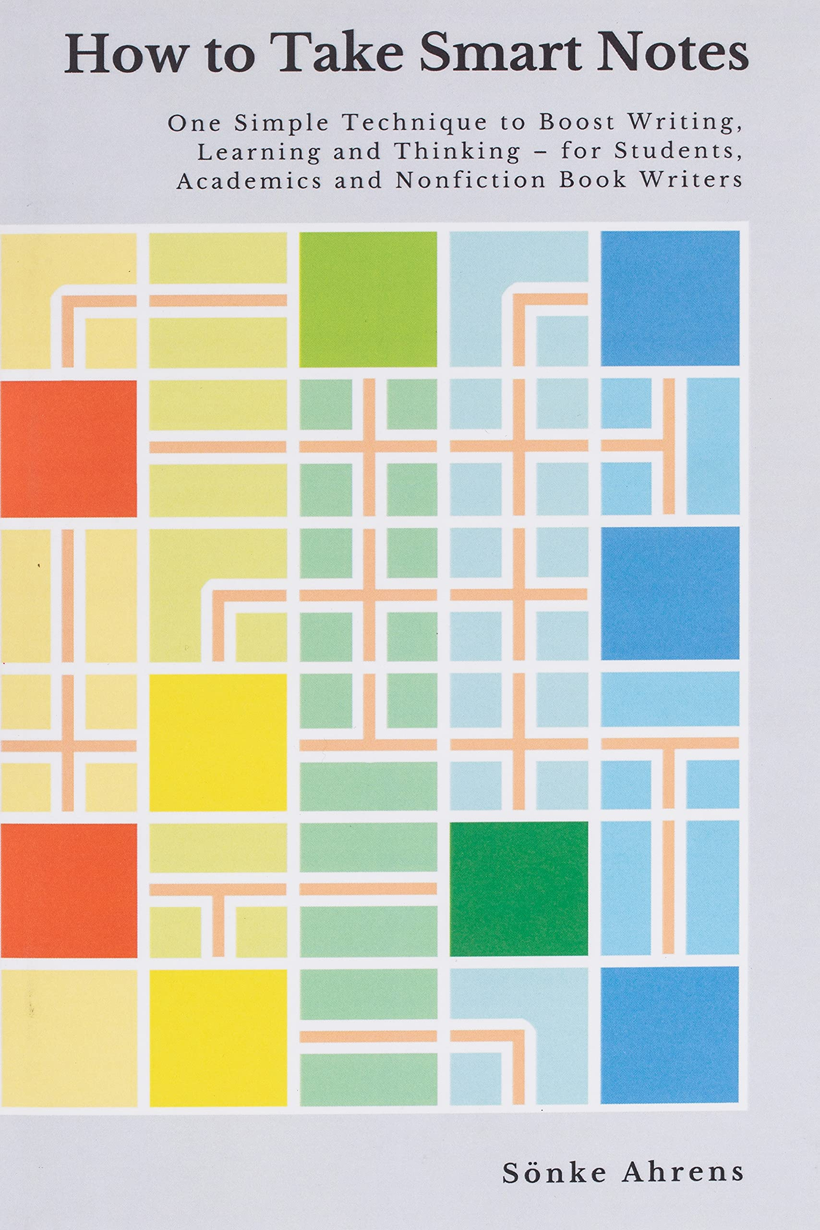
TRIGGER

Slide 3
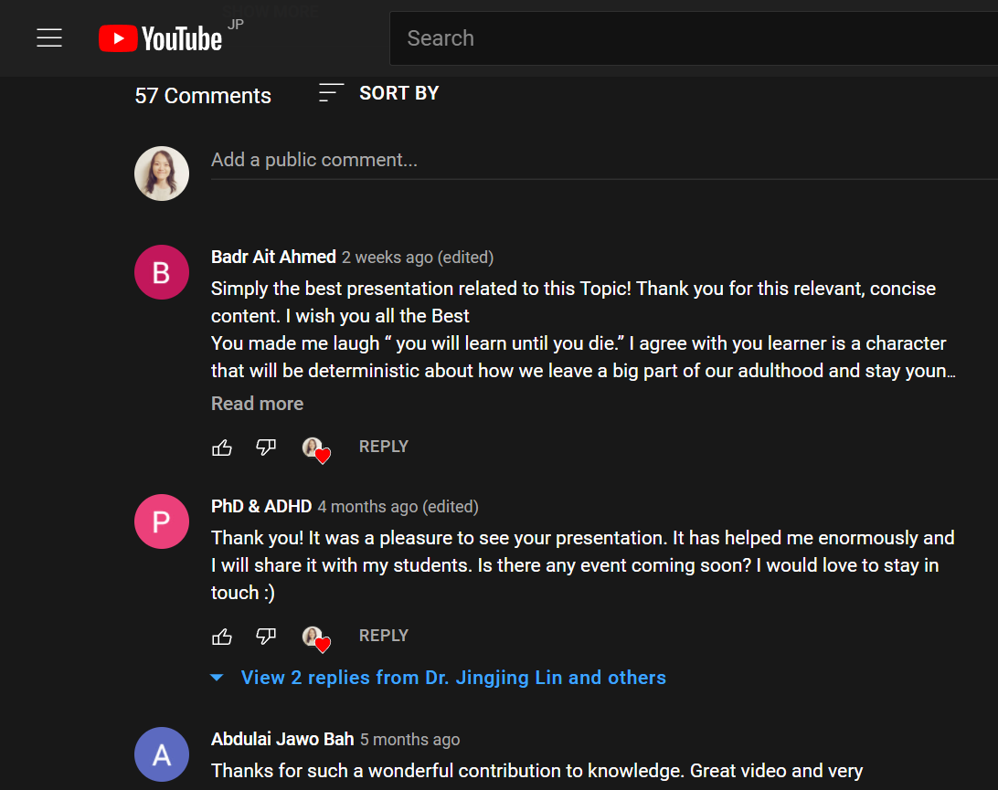
TRIGGER

Slide 4
REFLECTION
“
1956
Bloom’s Taxonomy
A higher level of cognitive activities (doing homework) does not need to wait until a learner completes a lower level of cognitive activities (remembering all materials taught in class).
Cognitive, Affective, Psychomotor.
Cognitive: knowledge, comprehension, application, analysis, synthesis, and evaluation
2001
Taxonomy for Teaching, Learning, and Assessment
”
Revised to:
remember, understand, apply, analyze, evaluate, and create

Slide 5
REALITY CHECK
1956
1994
Bloom’s Taxonomy
1983
1998
2001
Taxonomy for Teaching, Learning, and Assessment
2001
2007
2012
2002
2004
2006
2010
2016

Slide 6
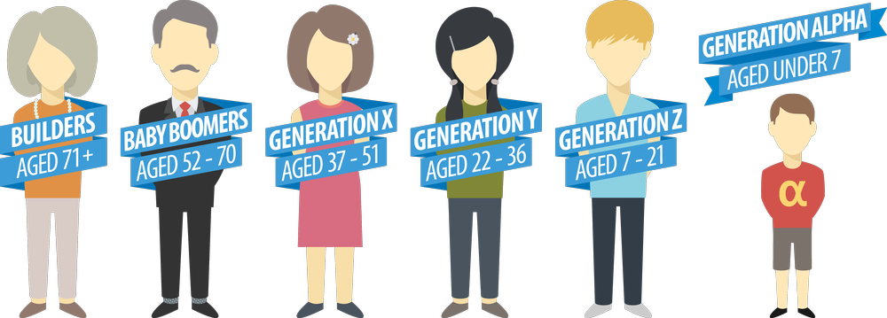
REALITY CHECK
NOW!
Instant
Gratification
NOW!
Author: McCrindle Research, from https://newbeach.co/generation-alpha-better-be-ready/

Slide 7
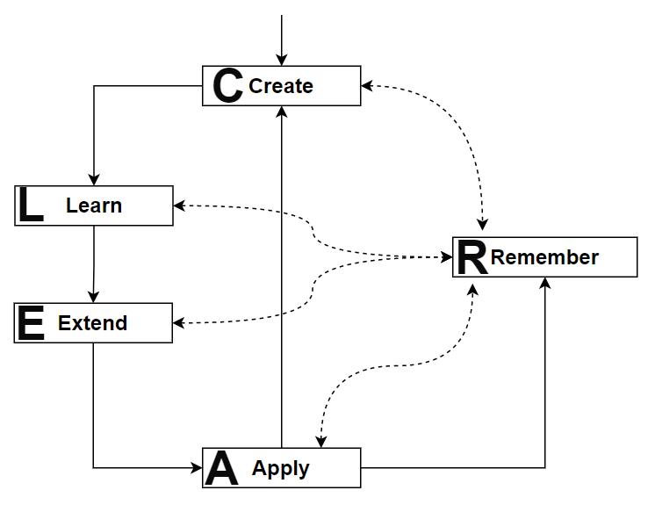
CLEAR: THEORY
Fig 1
Create > Remember
The CLEAR (Create, Learn, Extend, Apply, and Remember) Framework of Active Learning

Slide 8
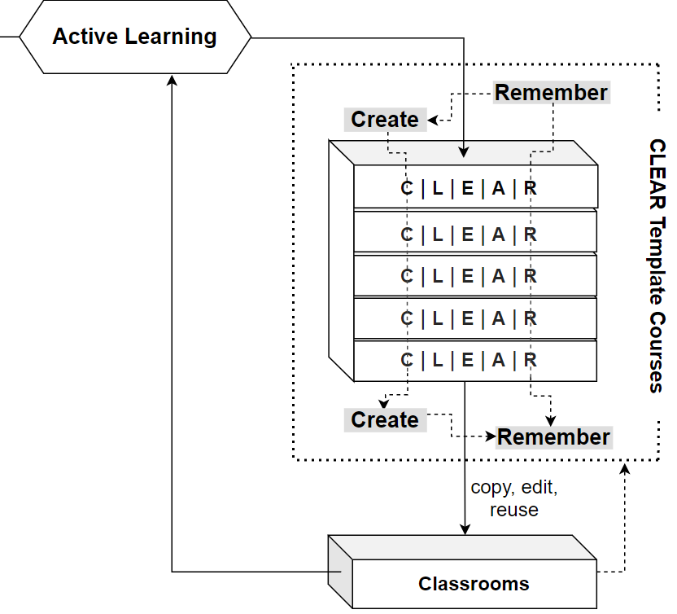
CLEAR: PRACTICE
Create > Remember
Fig 1
The CLEAR (Create, Learn, Extend, Apply, and Remember) Framework of Active Learning

Slide 9
CLEAR: PRACTICE
Create > Remember
Template Courses
Copy & Paste: Create a new course from template courses.
Modify: edit the template-based new course according to needs.
Deliver: enrol students and deliver the teaching.
Share: share the new course as new template in the database.

Slide 10
CLEAR: ADVANCEMENT
“
Simplicity
Simple to understand to easy to implement.
CLEAR model promotes “create to remember”. It can transform how STEM teachers are trained and how STEM courses are taught considering three following advancements in the framework.
Duality
A theory + A practice guide.
Basics
”
Return to a basic goal: help students remember.

Slide 11
ONGOING WORK
“
Evidence
Literature review to check the CLEAR model against research evidence.
CLEAR model are being validated by ongoing research.
Experts
Online interviews to check the CLEAR model against award-winning teachers.
Experiment
”
Control group pretest/posttest online experiment to evaluate the effectiveness of the CLEAR model as a course design model.

Slide 12
LINKED PROJECT
“
The CLEAR Initiative: To Foster Digital Changes in University-Level STEM Education and Faculty Development by Promoting Active Learning
Website
https://sites.google.com/view/clearinitiative
Host Institute
Center for IT-based Education, Toyohashi University of Technology, Japan
”

Slide 13
Q & A
EMAIL
LIN.JINGJING.QC@TUT.JP
Fig 1
The CLEAR (Create, Learn, Extend, Apply, and Remember) Framework of Active Learning

